Slide 1
W4111 – Introduction to Databases Section 003, V03, Fall 2024 Lecture 3: ER(2), Relational(2), SQL(2)
© Donald F. Ferguson, 2024

Slide 2
W4111 – Introduction to Databases Section 003, V03, Fall 2024 Lecture 3: ER(2), Relational(2), SQL(2)
We will start in a few minutes.
© Donald F. Ferguson, 2024

Slide 3

Today’s Contents
3 | COMS W4111_003_2024_3: Lecture 3: ER(2), Relational(2), SQL(2) © Donald F. Ferguson, 2024

Slide 4
Contents
Introduction and course updates.
ER Modeling (2).
Relational model and algebra (2).
SQL (2).
Homework and projects.

Slide 5
Introduction and course updates
5 | COMS W4111_003_2024_3: Lecture 3: ER(2), Relational(2), SQL(2) © Donald F. Ferguson, 2024

Slide 6
Course Updates
Homework assignments:
In general, a homework has two parts, e.g. HW1a and HW1b.
“a” is written questions, and you have one week to complete.
“b” is practical “tasks,” that also work towards a simple project at the end. You typically have two weeks to complete.
Tentative schedule:
HW1: 21-SEP
HW2: 5-OCT
HW3: 19-OCT
HW4: 2-NOV
HW5: 16-NOV
The midterm is 18-OCT. We will come up with accommodations for students that have “legitimate,” constraints, e.g. religious commitments.

Slide 7
ER Modeling
7 | COMS W4111_003_2024_3: Lecture 3: ER(2), Relational(2), SQL(2) © Donald F. Ferguson, 2024

Slide 8
Concepts
Introduction
8 | COMS W4111_003_2024_3: Lecture 3: ER(2), Relational(2), SQL(2) © Donald F. Ferguson, 2024

Slide 9
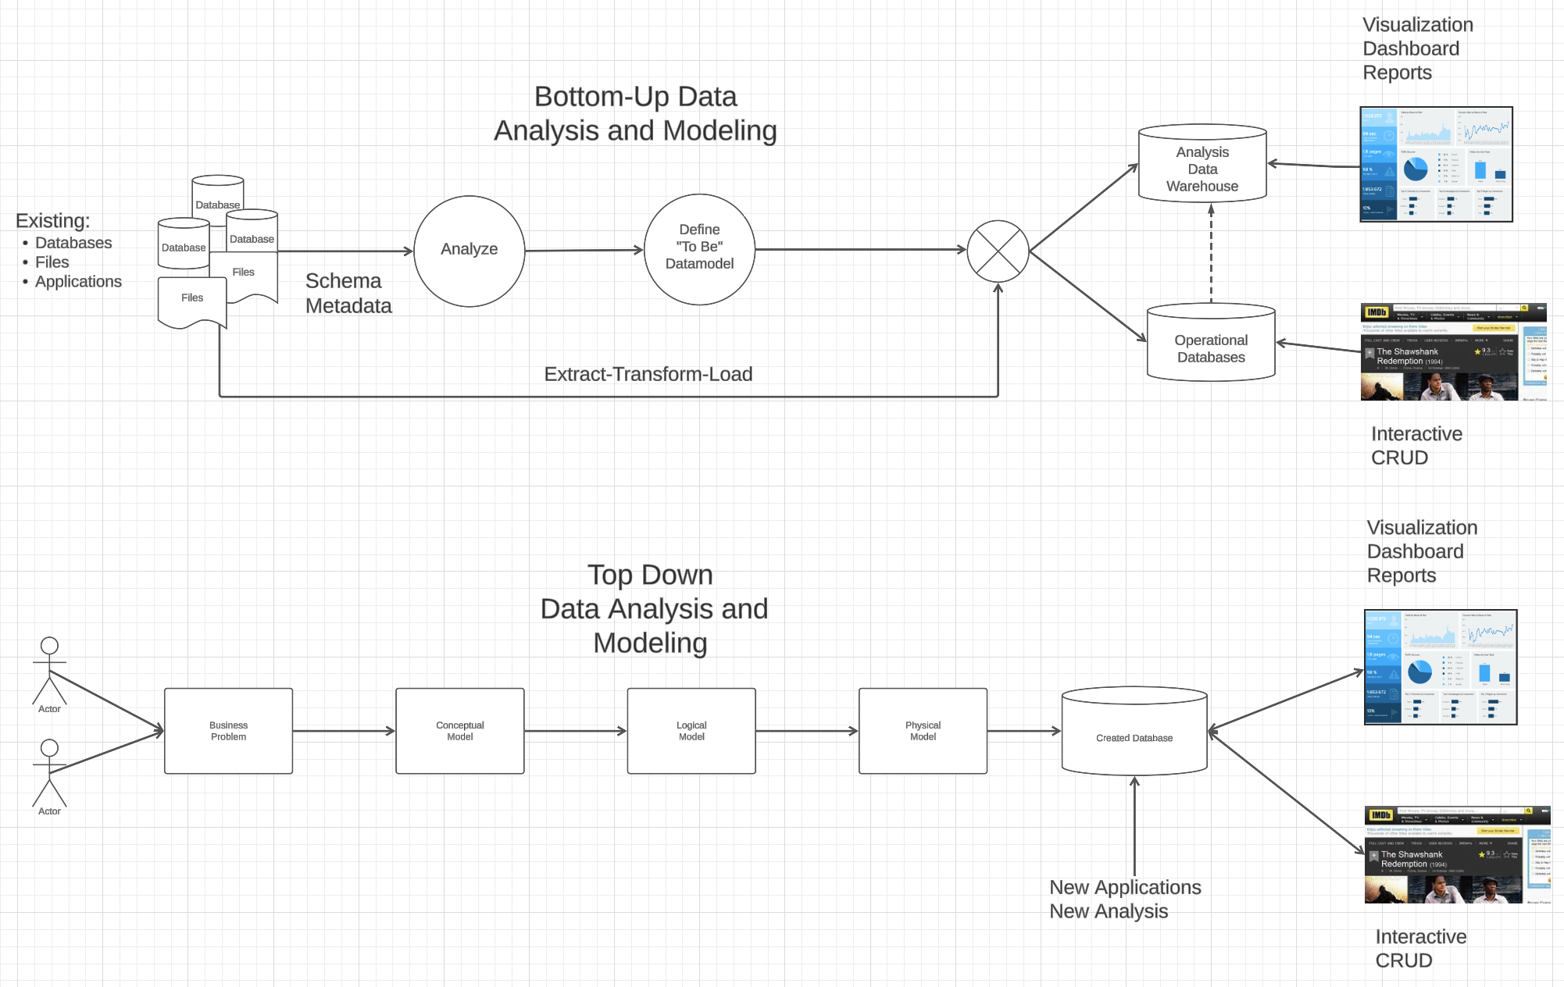
Modeling
Most of the time there is a mix → Meet-in-the-Middle

Slide 10
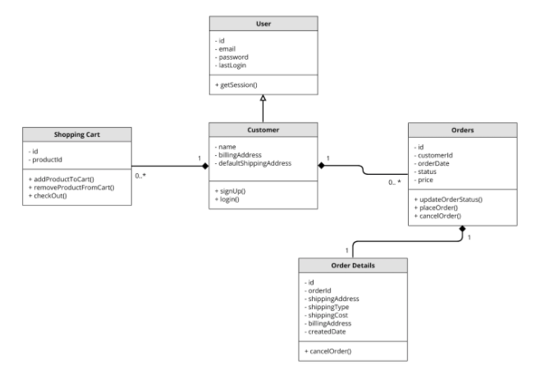
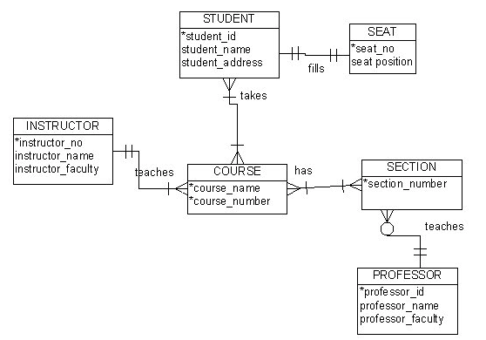
Visual Notation – Many Notations
ER Model
UML
“Other,” i.e. PowerPoint is the most common modeling notation.
It is easy to get “carried away.”
The trick is to do “just enough modeling.”
I mostly use Crow’s Foot
It is “just enough”
But lacks some capabilities.
The book uses ER notation.
Crow’s Foot

Slide 11
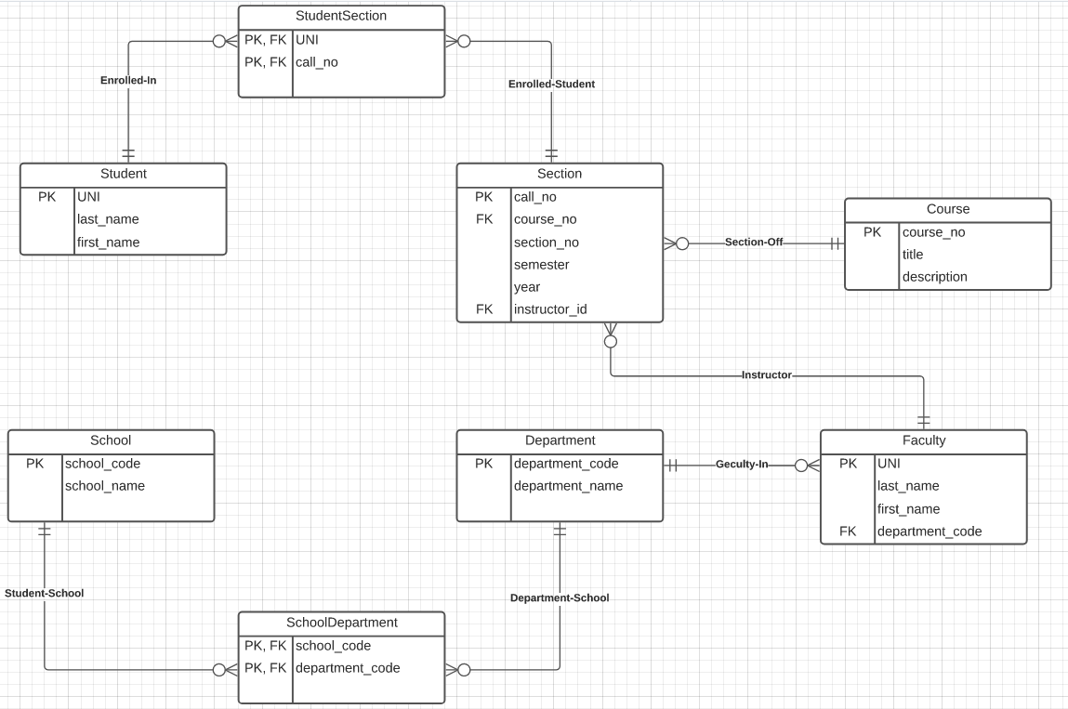
Notation has Precise Meaning (Crow’s Foot)
Attribute annotations:
PK = Primary Key
FK = Foreign Key
Line annotations:
We will learn over time and there are good tutorials (https://www.lucidchart.com/pages/er-diagrams) to help study and refresh.
We will spend a lot of time discussing keys.
We will start in a couple of slides.

Slide 12
Entity-Relational Modeling Design Patterns
Introduction
12 | COMS W4111_003_2024_3: Lecture 3: ER(2), Relational(2), SQL(2) © Donald F. Ferguson, 2024

Slide 13
Relationship Sets (Cont.)
An attribute can also be associated with a relationship set.
For instance, the advisor relationship set between entity sets instructor and student may have the attribute date which tracks when the student started being associated with the advisor

Slide 14
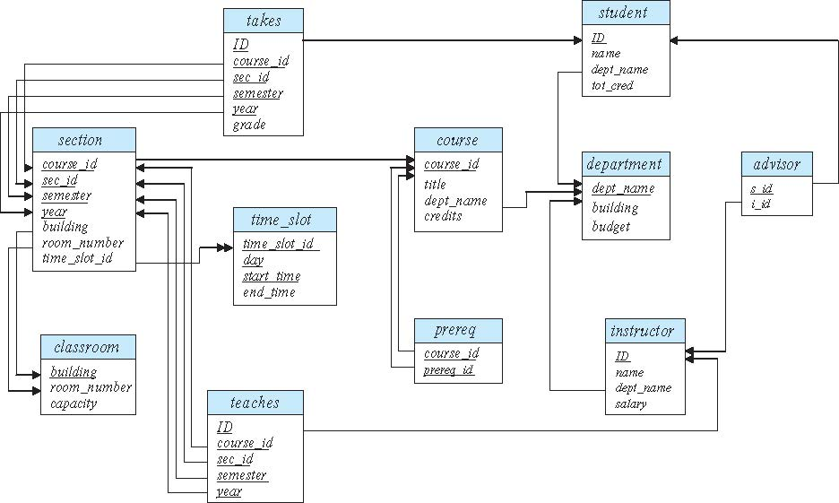
Schema Diagram for University Database
Note:
You can see that DataGrip uses a similar notation.
How creating a diagram in DataGrip.

Slide 15
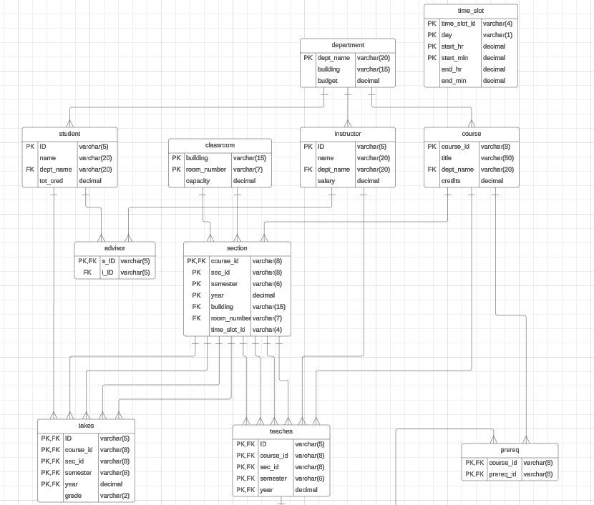
Some Observations
Note: I showed LucidChart reverse engineering last lecture.
Reverse engineering seems to have made some mistakes.
But, notice that sometimes:
Relationship are foreign keys, e.g. Section-Classroom
Are something else, e.g. Advisor
This something else is called and Associative Entity.
SQL requires and Associative Entity if
The relationship is many-to-many.
There are properties on the relationships.

Slide 16
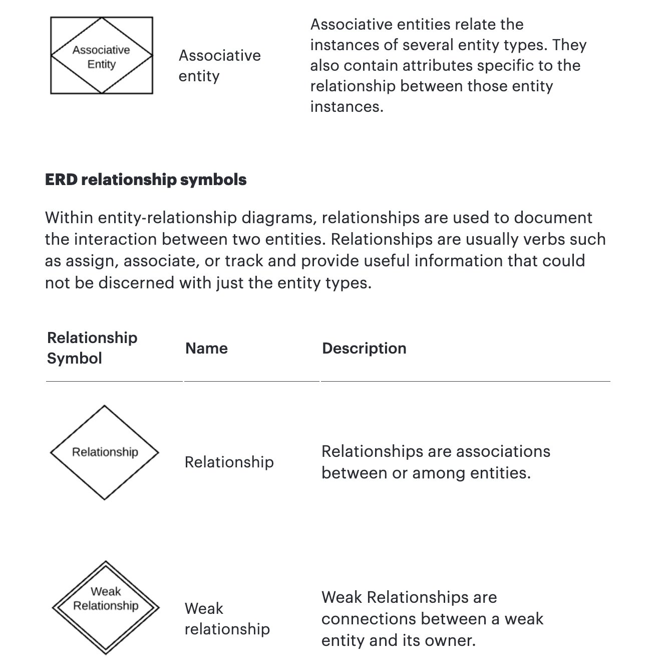
Associative Entity
The ER model represents “associations/relationships” as
First class “things”
That are different from “entities.”
The SQL model does not have “relationships” or associations as first-class types. You have
Tables
Columns
Keys
Constraints
… …
You can implement some “relationships” using foreign keys. Others require something more complex – an associative entity.

Slide 17
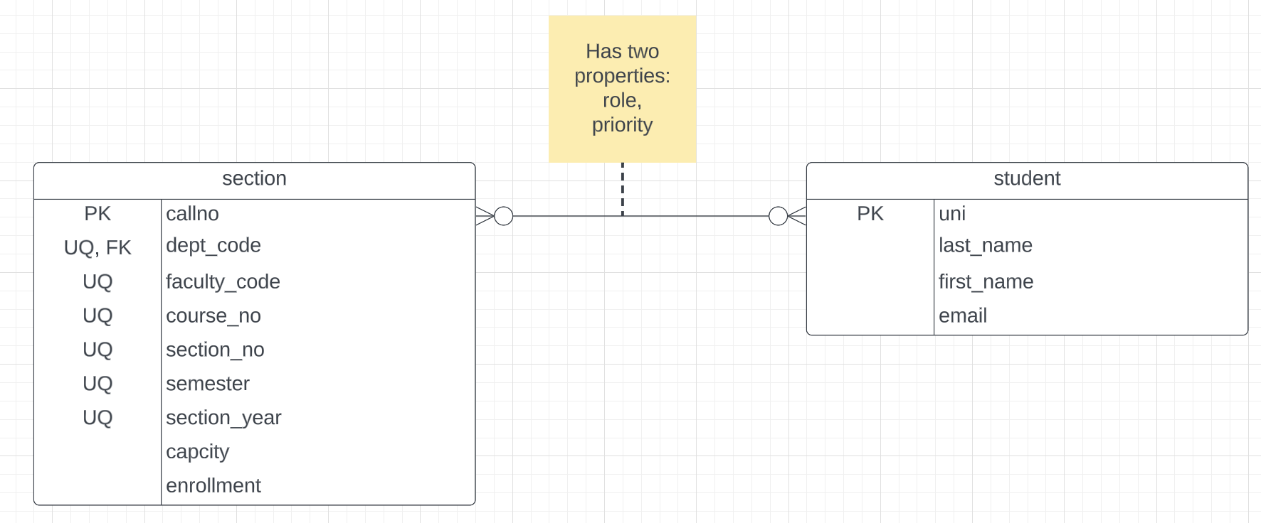
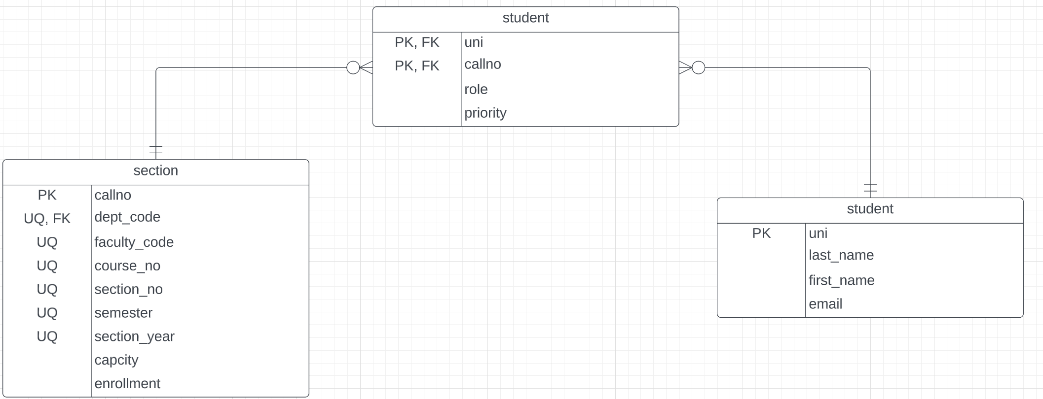
Associative Entity
“An associative entity is a term used in relational and entity–relationship theory. A relational database requires the implementation of a base relation (or base table) to resolve many-to-many relationships. A base relation representing this kind of entity is called, informally, an associative table.” (https://en.wikipedia.org/wiki/Associative_entity)
Consider Students – Sections:
This is many-to-many. There is no way to implement in SQL. You see this in the Advises table in the sample database.
The “relationship/association” has properties that are not attributes of the connected entities.
SQL Realization
Switch to notebook diagram.

Slide 18
Relationship Sets with Attributes

Slide 19
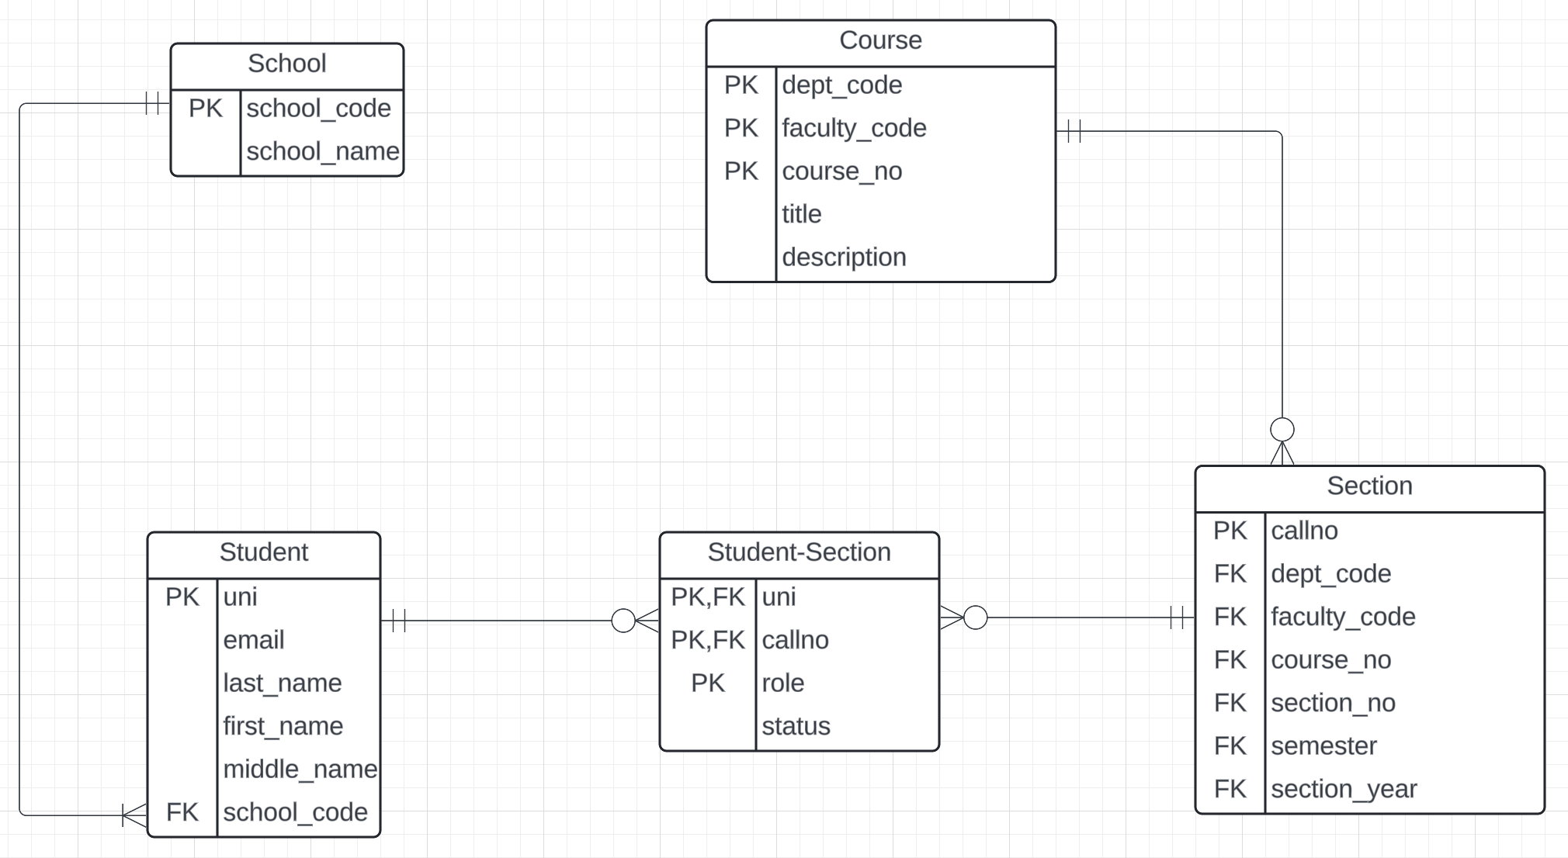
An Example from Columbia University Model
dff9@columbia.edu
dff9
dff@cs.columbia.edu
A student can have more than one relationship with a section, e.g.
Student
TA
-2

Slide 20
Roles
Entity sets of a relationship need not be distinct
Each occurrence of an entity set plays a “role” in the relationship
The labels “course_id” and “prereq_id” are called roles.

Slide 21
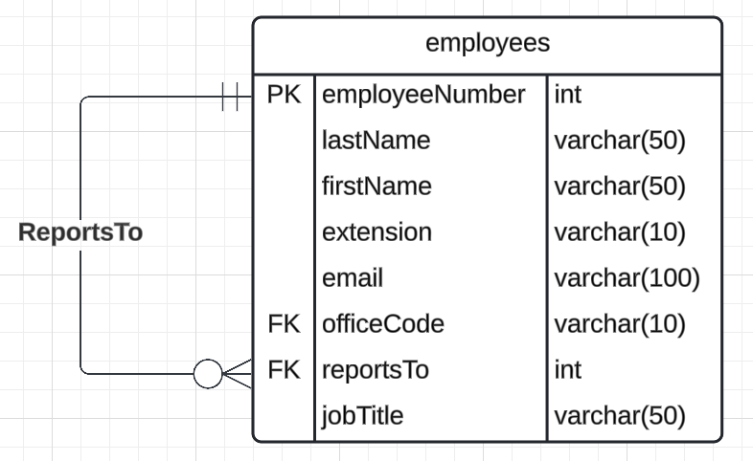
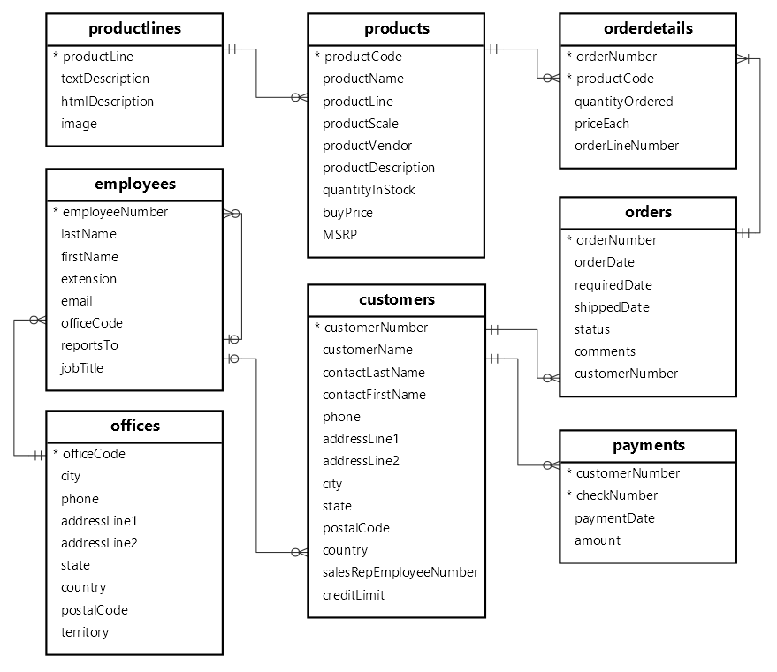
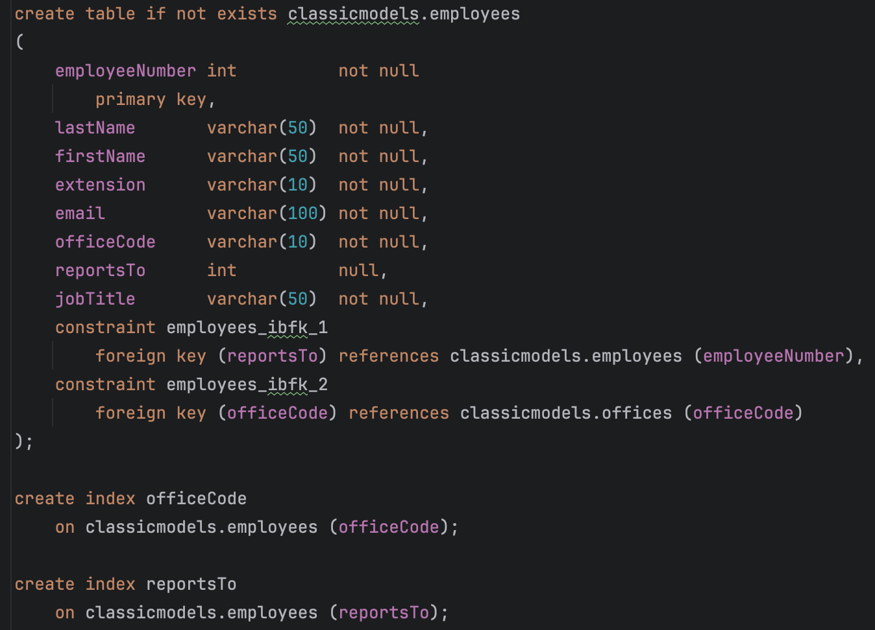
Another Example – Classic Models
Another simple but representative example we use is Classic Models (https://www.mysqltutorial.org/getting-started-with-mysql/mysql-sample-database/).
You can see an example of a non-distinct entity sets.

Slide 22
Degree of a Relationship Set
Binary relationship
involve two entity sets (or degree two).
most relationship sets in a database system are binary.
Relationships between more than two entity sets are rare. Most relationships are binary. (More on this later.)
Example: students work on research projects under the guidance of an instructor.
relationship proj_guide is a ternary relationship between instructor, student, and project

Slide 23
Non-binary Relationship Sets
Most relationship sets are binary
There are occasions when it is more convenient to represent relationships as non-binary.
E-R Diagram with a Ternary Relationship

Slide 24
Mapping Cardinality Constraints
Express the number of entities to which another entity can be associated via a relationship set.
Most useful in describing binary relationship sets.
For a binary relationship set the mapping cardinality must be one of the following types:
One to one
One to many
Many to one
Many to many

Slide 25
Let’s Examine and Do Some Examples
Introduction
25 | COMS W4111_003_2024_3: Lecture 3: ER(2), Relational(2), SQL(2) © Donald F. Ferguson, 2024

Slide 26
Relational Model
26 | COMS W4111_003_2024_3: Lecture 3: ER(2), Relational(2), SQL(2) © Donald F. Ferguson, 2024

Slide 27
Keys
Introduction
27 | COMS W4111_003_2024_3: Lecture 3: ER(2), Relational(2), SQL(2) © Donald F. Ferguson, 2024

Slide 28
Keys
1, Ferguson, COMS
2, Smith, EE
3, Duncan, MATH
Let K ⊆ R
instructor(id, name, dept_name) ➔ R = {id, name, dept_code}
{id, name}, {id}, {id, dept_name}
K is a superkey of R if values for K are sufficient to identify a unique tuple of each possible relation r(R)
Example: {ID} and {ID,name} are both superkeys of instructor.
Superkey K is a candidate key if K is minimal Example: {ID} is a candidate key for Instructor
One of the candidate keys is selected to be the primary key.
which one?
Foreign key constraint: Value in one relation must appear in another
Referencing relation
Referenced relation
Example: dept_name in instructor is a foreign key from instructor referencing department

Slide 29
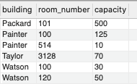
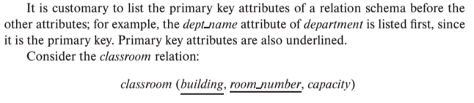
Notation
Classroom relation
classroom schema
Columns (Attributes)
Relation Name
Primary Key Columns
The primary key is a composite key. Neither column is a key (unique) by itself.
Keys are statements about all possible, valid tuples and not just the ones in the relation.
Capacity is unique in this specific data, but clearly not unique for all possible data.
In this domain, there cannot be two classrooms with the same building and room number.
Relation schema:
Underline indicates a primary key column. There is no standard way to indicate other types of key.
We will use bold to indicate foreign keys.
You will sometimes see things like classroom(building:string, room_number:number, capacity:number)

Slide 30
Observations
Keys:
Will be baffling. It takes time and experience to understand/appreciate.
There are many, many types of keys with formal definitions.
I explain the formality but focus on the concepts and applications.
No one uses the formal, relational model. So, why do we study it?
Is very helpful when understanding concepts that we cover later in the course, especially query optimization and processing.
There are many realizations of the model and algebra, and understanding the foundation helps with understanding language/engine capabilities.
The model has helped with innovating new approaches, and you may innovate in data and query models in your future.

Slide 31
A Note on Keys
Relational model/algebra:
In the “pure” model, foreign keys reference primary keys.
This is not always the case in “real” databases and SQL.
There is no standard/common way to show foreign keys in relational schema. If I ask you to do it, you can pick a convention and add a note, e.g.
Student(ID, dept_code, name, tot_cred)
When doing modeling for implementations, there are many kinds/styles of key:
Alternate UNI, email
Composite 202149 (COMS, W, 4111, 003, 003, 2024)
Natural (COMS, W, 4111, “Introduction to Database”, “The worst experience of your life.”)
Surrogate (dff9, Ferguson, Donald, F., 012345, dff9@Columbia.edu)
Unique
… …

Slide 32
Relational Algebra (2) More Advanced Operators
Introduction
32 | COMS W4111_003_2024_3: Lecture 3: ER(2), Relational(2), SQL(2) © Donald F. Ferguson, 2024

Slide 33
Relational Query Languages
Procedural versus non-procedural, or declarative
“Pure” languages:
Relational algebra
Tuple relational calculus
Domain relational calculus
The above 3 pure languages are equivalent in computing power
We will concentrate in this chapter on relational algebra
Not turning-machine equivalent
Consists of 6 basic operations
DFF Comments:
You will sometimes see other operator, e.g. ← Assignment.
Relational algebra focuses on retrieve. You can sort of do Create, Update, Delete.
The SQL Language, which we will see, extends relational algebra.

Slide 34
Relational Algebra
A procedural language consisting of a set of operations that take one or two relations as input and produce a new relation as their result.
Six basic operators
select: σ
project: ∏
union: ∪
set difference: –
Cartesian product: x
rename: ρ

Slide 35
Join Operation
The Cartesian-Product
instructor X teaches
associates every tuple of instructor with every tuple of teaches.
Most of the resulting rows have information about instructors who did NOT teach a particular course.
To get only those tuples of “instructor X teaches “ that pertain to instructors and the courses that they taught, we write:
σ _{instructor.id = teaches.id} (instructor x teaches ))
We get only those tuples of “instructor X teaches” that pertain to instructors and the courses that they taught.
The result of this expression, shown in the next slide
A fundamental definition:
σ _{instructor.ID=teaches.ID} (instructor ⨯ teaches) = instructor ⨝ teaches
⨝ is the JOIN operations.

Slide 36
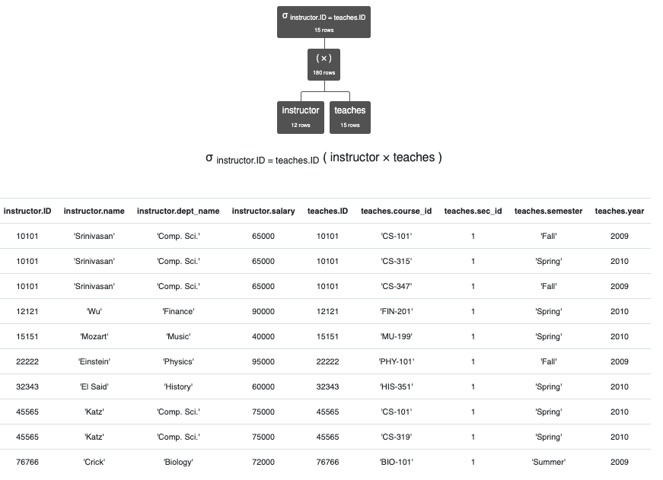
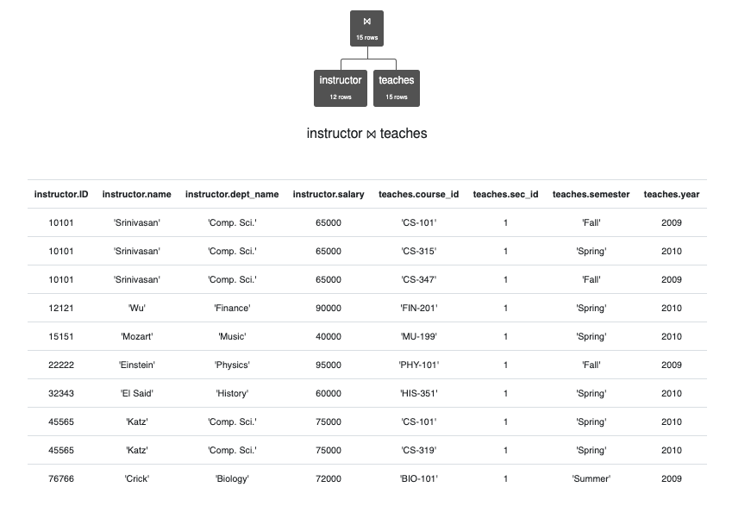
JOIN Definition
σ _{instructor.ID=teaches.ID} (instructor ⨯ teaches)
instructor ⨝ teaches
instructor ⨝ _{instructor.ID>teaches.ID} teaches

Slide 37
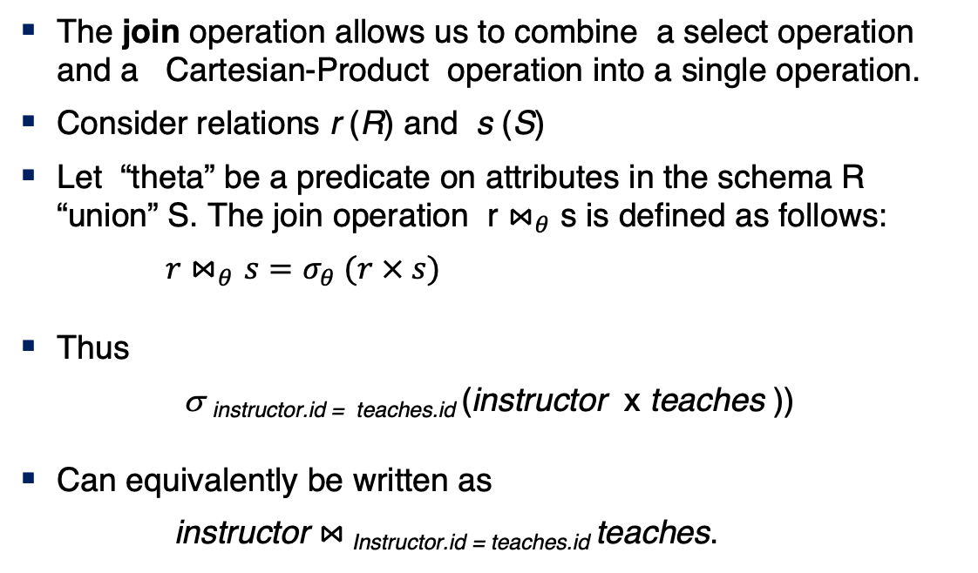
Join Operation (Cont.)
The join operation allows us to combine a select operation and a Cartesian-Product operation into a single operation.
Consider relations r (R) and s (S)
Let “theta” be a predicate on attributes in the schema R “union” S. The join operation r $⋈_{θ}$ s is defined as follows:
$r⋈_{θ}s=σ_{θ} (r × s)$
Thus
σ _{instructor.id = teaches.id} (instructor x teaches ))
Can equivalently be written as
instructor $⋈_{ }$_{Instructor.id = teaches.id} teaches.

Slide 38
The Dreaded Relax Calculator
Let’s look at an online tool that you will use.
RelaX (https://dbis-uibk.github.io/relax/calc/local/uibk/local/0)
The calculator:
Has an older version of the data from the recommended textbook. (https://dbis-uibk.github.io/relax/calc/gist/4f7866c17624ca9dfa85ed2482078be8/relax-silberschatz-english.txt/0)
You can also upload new data.
Some queries:
σ dept_name='Comp. Sci.' ∨ dept_name='History' (department)
π name, dept_name (instructor)
π ID, name ( σ dept_name='Comp. Sci.' (instructor) )

Slide 39
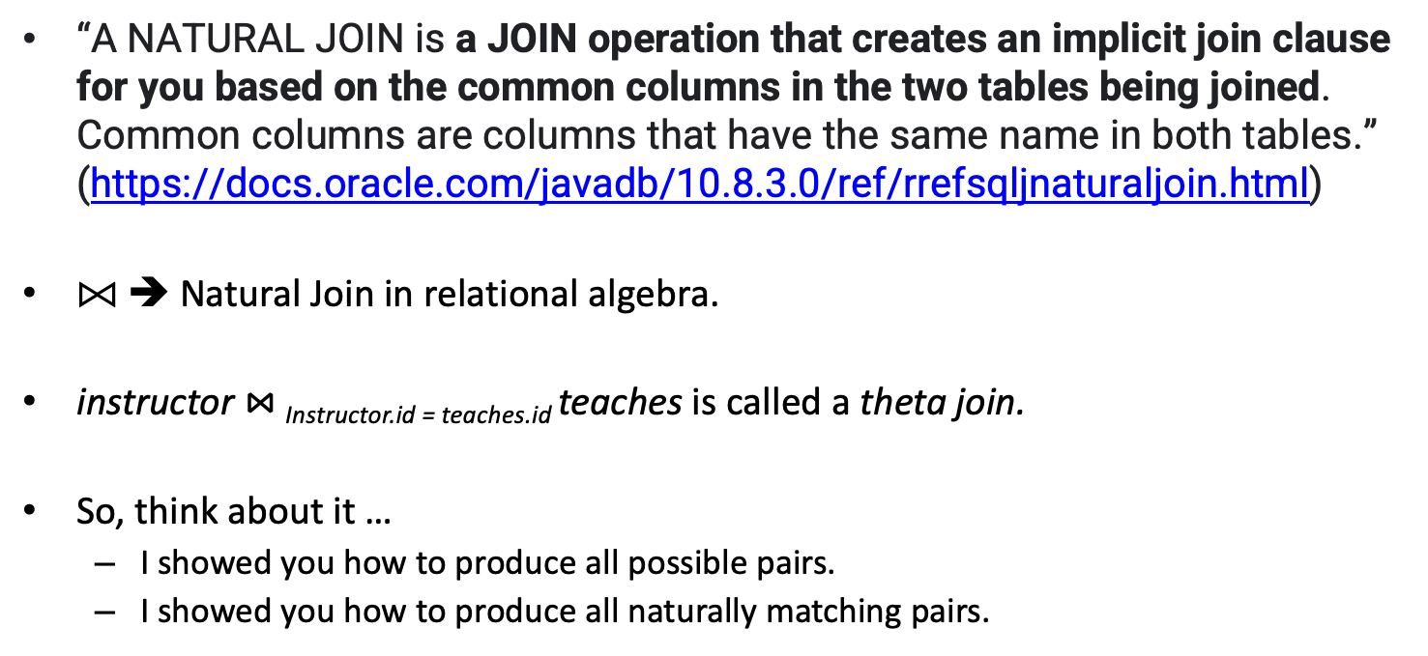
Some Terms
“A NATURAL JOIN is a JOIN operation that creates an implicit join clause for you based on the common columns in the two tables being joined. Common columns are columns that have the same name in both tables.” (https://docs.oracle.com/javadb/10.8.3.0/ref/rrefsqljnaturaljoin.html)
⨝ ➔ Natural Join in relational algebra.
instructor $⋈_{ }$_{Instructor.id = teaches.id} teaches is called a theta join.
So, think about it …
I showed you how to produce all possible pairs.
I showed you how to produce all naturally matching pairs.

Slide 40
What are all those other Symbols? (Will Cover)
Some of these are pretty obscure
Division
Anti-Join
Left semi-join
Right semi-join
Most SQL engines do not support them.
You can implement them using combinations of JOIN, SELECT, WHERE, ... ...
But, I cannot every remember using them in applications I have developed.
Outer JOIN is very useful, but less common. We will cover.
There are also some “patterns” or “terms”
Equijoin
Non-equi join
Natural join
Theta join
... ...
I may ask you to define these terms on some exams because they may be common internships/job interview questions.
τ order by
γ group by
¬ negation
÷ set division
⨝ natural join, theta-join
⟕ left outer join
⟖ right outer join
⟗ full outer join
⋉ left semi join
⋊ right semi join
▷ anti-join

Slide 41
Let’s Do Some Examples
Introduction
41 | COMS W4111_003_2024_3: Lecture 3: ER(2), Relational(2), SQL(2) © Donald F. Ferguson, 2024

Slide 42
SQL
42 | COMS W4111_003_2024_3: Lecture 3: ER(2), Relational(2), SQL(2) © Donald F. Ferguson, 2024

Slide 43
Data Definition Language
Introduction
43 | COMS W4111_003_2024_3: Lecture 3: ER(2), Relational(2), SQL(2) © Donald F. Ferguson, 2024

Slide 44
Data Definition Language
The SQL data-definition language (DDL) allows the specification of information about relations, including:
The schema for each relation.
The type of values associated with each attribute.
The Integrity constraints
The set of indices to be maintained for each relation.
Security and authorization information for each relation.
The physical storage structure of each relation on disk.

Slide 45
Domain Types in SQL
char(n). Fixed length character string, with user-specified length n.
varchar(n). Variable length character strings, with user-specified maximum length n.
int. Integer (a finite subset of the integers that is machine-dependent).
smallint. Small integer (a machine-dependent subset of the integer domain type).
numeric(p,d). Fixed point number, with user-specified precision of p digits, with d digits to the right of decimal point. (ex., numeric(3,1), allows 44.5 to be stores exactly, but not 444.5 or 0.32)
real, double precision. Floating point and double-precision floating point numbers, with machine-dependent precision.
float(n). Floating point number, with user-specified precision of at least n digits.
More are covered in Chapter 4.

Slide 46
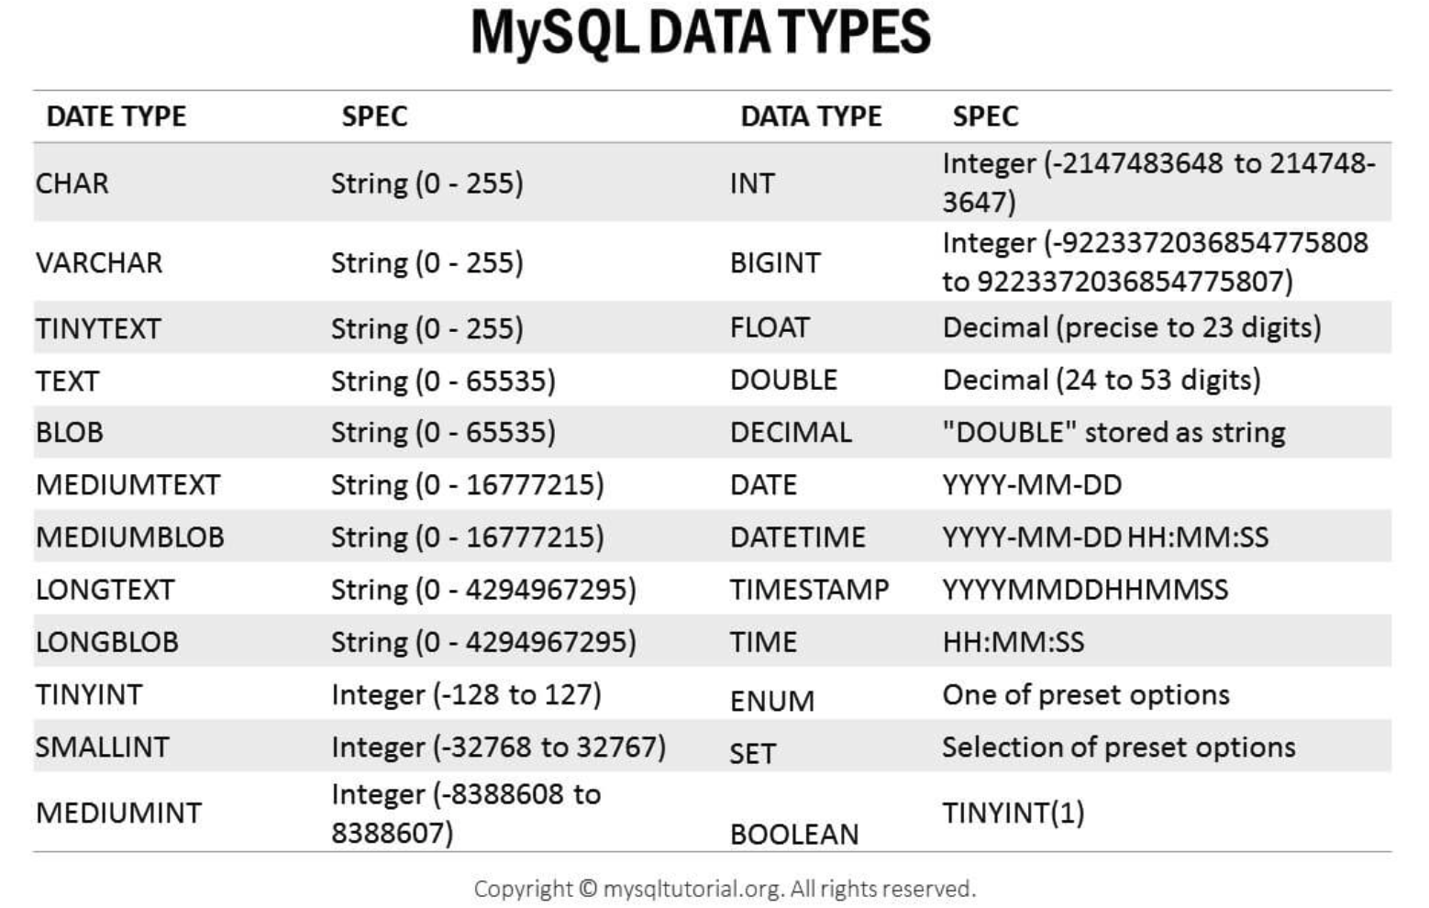
MySQL Data Types (Subset)
Note: Scroll through https://www.mysqldatatypes.com/

Slide 47
Create Table Construct
An SQL relation is defined using the create table command:
create table r
(A₁ D₁, A₂ D₂, ..., A_{n} D_{n}, (integrity-constraint₁), ..., (integrity-constraint_{k}))
r is the name of the relation
each A_{i} is an attribute name in the schema of relation r
D_{i} is the data type of values in the domain of attribute A_{i}
Example:
create table instructor ( ID char(5), name varchar(20), dept_name varchar(20), salary numeric(8,2))

Slide 48
Integrity Constraints in Create Table
Types of integrity constraints
primary key (A₁, ..., A_{n} )
foreign key (A_{m}, ..., A_{n} ) references r
not null
SQL prevents any update to the database that violates an integrity constraint.
Example:
create table instructor ( ID char(5), name varchar(20) not null, dept_name varchar(20), salary numeric(8,2), primary key (ID), foreign key (dept_name) references department);

Slide 49
And a Few More Relation Definitions
create table student ( ID varchar(5), name varchar(20) not null, dept_name varchar(20), tot_cred numeric(3,0), primary key (ID),
foreign key (dept_name) references department);
create table takes ( ID varchar(5), course_id varchar(8), sec_id varchar(8), semester varchar(6), year numeric(4,0), grade varchar(2),
primary key (ID, course_id, sec_id, semester, year) ,
foreign key (ID) references student, foreign key (course_id, sec_id, semester, year) references section);

Slide 50
And more still
create table course ( course_id varchar(8), title varchar(50), dept_name varchar(20), credits numeric(2,0),
primary key (course_id),
foreign key (dept_name) references department);

Slide 51
Integrity Constraints
Integrity constraints guard against accidental damage to the database, by ensuring that authorized changes to the database do not result in a loss of data consistency.
A checking account must have a balance greater than $10,000.00
A salary of a bank employee must be at least $4.00 an hour
A customer must have a (non-null) phone number

Slide 52
Constraints on a Single Relation
not null
primary key
unique
check (P), where P is a predicate

Slide 53
Not Null Constraints
not null
Declare name and budget to be not null
name varchar(20) not null budget numeric(12,2) not null

Slide 54
Unique Constraints
unique ( A₁, A₂, …, A_{m})
The unique specification states that the attributes A₁, A₂, …, A_{m} form a candidate key.
Candidate keys are permitted to be null (in contrast to primary keys).

Slide 55
The check clause
The check (P) clause specifies a predicate P that must be satisfied by every tuple in a relation.
Example: ensure that semester is one of fall, winter, spring or summer
create table section
(course_id varchar (8),
sec_id varchar (8),
semester varchar (6),
year numeric (4,0),
building varchar (15),
room_number varchar (7),
time slot id varchar (4),
primary key (course_id, sec_id, semester, year),
check (semester in ('Fall', 'Winter', 'Spring', 'Summer')))

Slide 56
Referential Integrity
Ensures that a value that appears in one relation for a given set of attributes also appears for a certain set of attributes in another relation.
Example: If “Biology” is a department name appearing in one of the tuples in the instructor relation, then there exists a tuple in the department relation for “Biology”.
Let A be a set of attributes. Let R and S be two relations that contain attributes A and where A is the primary key of S. A is said to be a foreign key of R if for any values of A appearing in R these values also appear in S.

Slide 57
Referential Integrity (Cont.)
Foreign keys can be specified as part of the SQL create table statement
foreign key (dept_name) references department
By default, a foreign key references the primary-key attributes of the referenced table.
SQL allows a list of attributes of the referenced relation to be specified explicitly.
foreign key (dept_name) references department (dept_name)

Slide 58
Cascading Actions in Referential Integrity
When a referential-integrity constraint is violated, the normal procedure is to reject the action that caused the violation.
An alternative, in case of delete or update is to cascade
create table course ( (… dept_name varchar(20), foreign key (dept_name) references department on delete cascade on update cascade, . . .)
Instead of cascade we can use :
set null,
set default

Slide 59
Integrity Constraint Violation During Transactions
Consider:
create table person ( ID char(10), name char(40), mother char(10), father char(10), primary key ID, foreign key father references person, foreign key mother references person)
How to insert a tuple without causing constraint violation?
Insert father and mother of a person before inserting person
OR, set father and mother to null initially, update after inserting all persons (not possible if father and mother attributes declared to be not null)
OR defer constraint checking

Slide 60
Let’s Do Some Examples
Generated values for section ID.
Enumerations for faculty code and section.
Check constrains.
… …
Introduction
60 | COMS W4111_003_2024_3: Lecture 3: ER(2), Relational(2), SQL(2) © Donald F. Ferguson, 2024

Slide 61
JOIN Operator
Introduction
61 | COMS W4111_003_2024_3: Lecture 3: ER(2), Relational(2), SQL(2) © Donald F. Ferguson, 2024

Slide 62
Joined Relations
Join operations take two relations and return as a result another relation.
A join operation is a Cartesian product which requires that tuples in the two relations match (under some condition). It also specifies the attributes that are present in the result of the join
The join operations are typically used as subquery expressions in the from clause
Three types of joins:
Natural join
Inner join
Outer join
Notes:
You will also hear terms like equi-join, non-equi-join, theta join, semi-join, ... ...
I ask for definitions on exams, but you can just look them up.

Slide 63
Natural Join in SQL
Natural join matches tuples with the same values for all common attributes, and retains only one copy of each common column.
List the names of instructors along with the course ID of the courses that they taught
select name, course_id from students, takes, where student.ID = takes.ID;
Same query in SQL with “natural join” construct
select name, course_id from student natural join takes;

Slide 64
Natural Join in SQL (Cont.)
The from clause can have multiple relations combined using natural join:
select A₁, A₂, … A_{n} from r₁ natural join r₂ natural join .. natural join r_{n} where P ;

Slide 65
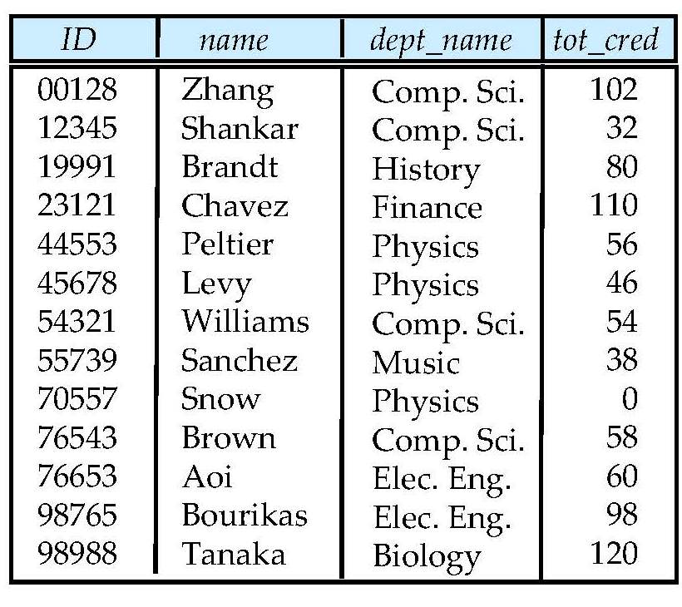
Student Relation

Slide 66
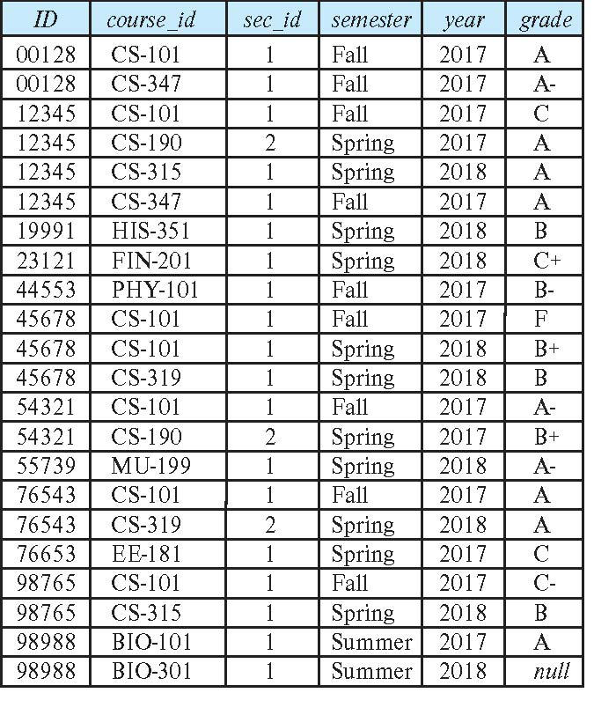
Takes Relation

Slide 67
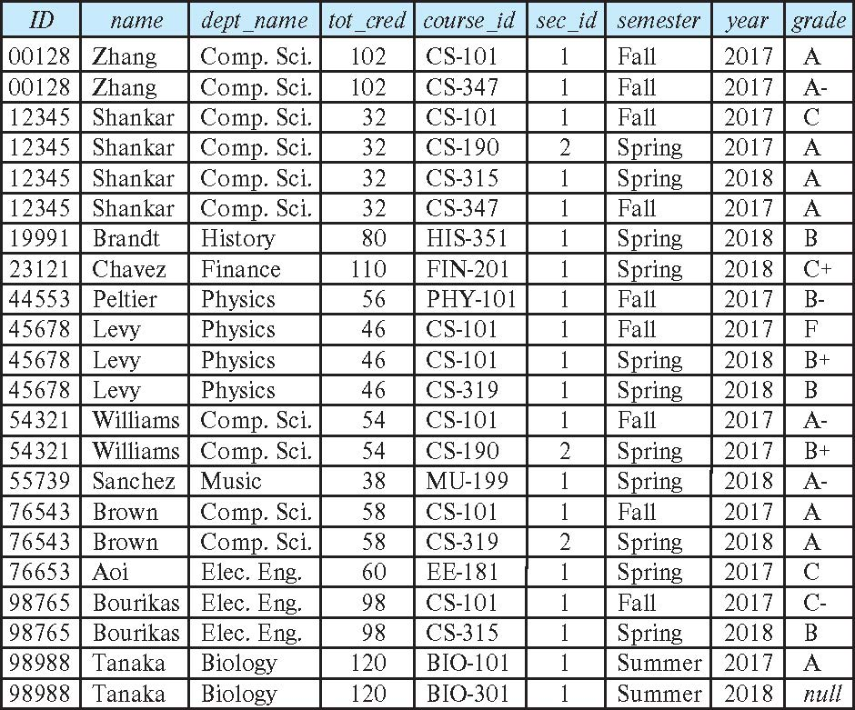
student natural join takes

Slide 68
Dangerous in Natural Join
Beware of unrelated attributes with same name which get equated incorrectly
Example -- List the names of students instructors along with the titles of courses that they have taken
Correct version
select name, title from student natural join takes, course where takes.course_id = course.course_id;
Incorrect version
select name, title from student natural join takes natural join course;
This query omits all (student name, course title) pairs where the student takes a course in a department other than the student's own department.
The correct version (above), correctly outputs such pairs.

Slide 69
Natural Join with Using Clause
To avoid the danger of equating attributes erroneously, we can use the “using” construct that allows us to specify exactly which columns should be equated.
Query example
select name, title from (student natural join takes) join course using (course_id)

Slide 70
Join Condition
The on condition allows a general predicate over the relations being joined
This predicate is written like a where clause predicate except for the use of the keyword on
Query example
select * from student join takes on student_ID = takes_ID
The on condition above specifies that a tuple from student matches a tuple from takes if their ID values are equal.
Equivalent to:
select * from student , takes where student_ID = takes_ID

Slide 71
Join Condition (Cont.)
The on condition allows a general predicate over the relations being joined.
This predicate is written like a where clause predicate except for the use of the keyword on.
Query example
select * from student join takes on student_ID = takes_ID
The on condition above specifies that a tuple from student matches a tuple from takes if their ID values are equal.
Equivalent to:
select * from student , takes where student_ID = takes_ID

Slide 72
One Way to Think About Joins

Slide 73
Database Modification
Introduction
73 | COMS W4111_003_2024_3: Lecture 3: ER(2), Relational(2), SQL(2) © Donald F. Ferguson, 2024

Slide 74
Modification of the Database
Deletion of tuples from a given relation.
Insertion of new tuples into a given relation
Updating of values in some tuples in a given relation

Slide 75
Deletion
Delete all instructors
delete from instructor
Delete all instructors from the Finance department delete from instructor where dept_name= 'Finance’;
Delete all tuples in the instructor relation for those instructors associated with a department located in the Watson building.
delete from instructor where dept name in (select dept name from department where building = 'Watson');

Slide 76
Deletion (Cont.)
Delete all instructors whose salary is less than the average salary of instructors
Problem: as we delete tuples from instructor, the average salary changes
Solution used in SQL:
First, compute avg (salary) and find all tuples to delete
Next, delete all tuples found above (without recomputing avg or retesting the tuples)
delete from instructor
where salary < (select avg (salary)
from instructor);

Slide 77
Insertion
Add a new tuple to course
insert into course values ('CS-437', 'Database Systems', 'Comp. Sci.', 4);
or equivalently
insert into course (course_id, title, dept_name, credits) values ('CS-437', 'Database Systems', 'Comp. Sci.', 4);
Add a new tuple to student with tot_creds set to null
insert into student values ('3003', 'Green', 'Finance', null);

Slide 78
Insertion (Cont.)
Make each student in the Music department who has earned more than 144 credit hours an instructor in the Music department with a salary of $18,000.
insert into instructor select ID, name, dept_name, 18000 from student where dept_name = 'Music' and total_cred > 144;
The select from where statement is evaluated fully before any of its results are inserted into the relation.
Otherwise queries like
insert into table1 select * from table1
would cause problem

Slide 79
Updates
Give a 5% salary raise to all instructors
update instructor set salary = salary * 1.05
Give a 5% salary raise to those instructors who earn less than 70000 update instructor set salary = salary * 1.05 where salary < 70000;
Give a 5% salary raise to instructors whose salary is less than average
update instructor set salary = salary * 1.05 where salary < (select avg (salary) from instructor);

Slide 80
Updates (Cont.)
Increase salaries of instructors whose salary is over $100,000 by 3%, and all others by a 5%
Write two update statements:
update instructor set salary = salary * 1.03 where salary > 100000; update instructor set salary = salary * 1.05 where salary <= 100000;
The order is important
Can be done better using the case statement (next slide)

Slide 81
Wrap Up
81 | COMS W4111_003_2024_3: Lecture 3: ER(2), Relational(2), SQL(2) © Donald F. Ferguson, 2024

